Slide 1
PYTHON – FOR LOOP

Slide 2
Definite Loops
Quite often we have a list of items of the lines in a file - effectively a finite set of things
We can write a loop to run the loop once for each of the items in a set using the Python for construct
These loops are called “definite loops” because they execute an exact number of times
We say that “definite loops iterate through the members of a set”

Slide 3
A Simple Definite Loop
5
4
3
2
1
Blastoff!
for i in [5, 4, 3, 2, 1] :
print(i)
print('Blastoff!')

Slide 4
A Definite Loop with Strings
Happy New Year: Joseph
Happy New Year: Glenn
Happy New Year: Sally
Done!
friends = ['Joseph', 'Glenn', 'Sally']
for friend in friends :
print('Happy New Year:', friend)
print('Done!')

Slide 5
A Simple Definite Loop
Yes
Done?
No
Move i ahead
5
4
3
2
1
Blastoff!
for i in [5, 4, 3, 2, 1] :
print(i)
print('Blastoff!')
print(i)
Definite loops (for loops) have explicit iteration variables that change each time through a loop. These iteration variables move through the sequence or set.
print('Blast off!')

Slide 6
Looking at in...
The iteration variable “iterates” through the sequence (ordered set)
The block (body) of code is executed once for each value in the sequence
The iteration variable moves through all of the values in the sequence
Five-element sequence
Iteration variable
for i in [5, 4, 3, 2, 1] :
print(i)

Slide 7
No
Yes
Done?
The iteration variable “iterates” through the sequence (ordered set)
The block (body) of code is executed once for each value in the sequence
The iteration variable moves through all of the values in the sequence
Move i ahead
print(i)
for i in [5, 4, 3, 2, 1] :
print(i)

Slide 8
i = 5
No
Yes
Done?
print(i)
Move i ahead
i = 4
print(i)
print(i)
i = 3
print(i)
i = 2
for i in [5, 4, 3, 2, 1] :
print(i)
print(i)
i = 1
print(i)

Slide 9
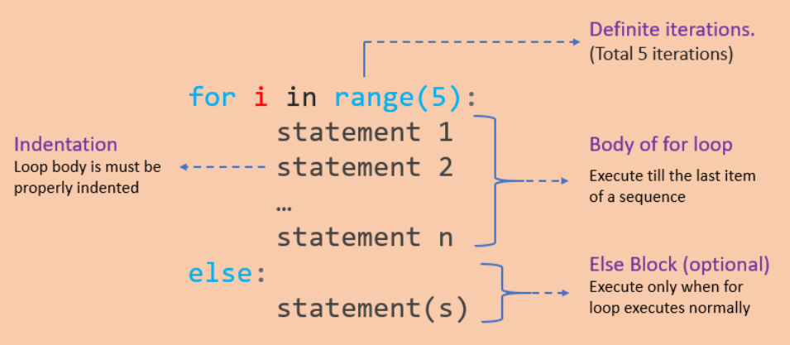
FOR LOOP
Used to iterate over a sequence like list, tuple, string or other
Loop continues until we reach the last item in the sequence
Identation

Slide 10
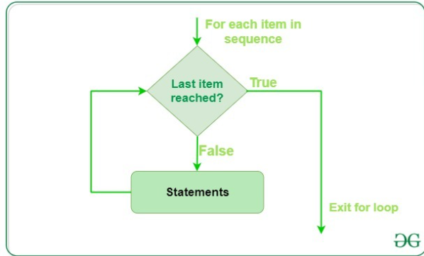
FOR LOOP – FLOW CONTROL

Slide 11
RANGE()
Generate a sequence of numbers using range() function
range(start, stop,step_size)
Not an iterator since it supports in, len and __getitem__ operations

Slide 12
FOR…ELSE STATEMENT
for...else statement can be used with the break keyword to run the else block only when the break keyword was not executed

Slide 13
Making “smart” loops
The trick is “knowing” something about the whole loop when you are stuck writing code that only sees one entry at a time
Set some variables to initial values
for thing in data:
Look for something or do something to each entry separately, updating a variable
Look at the variables

Slide 14
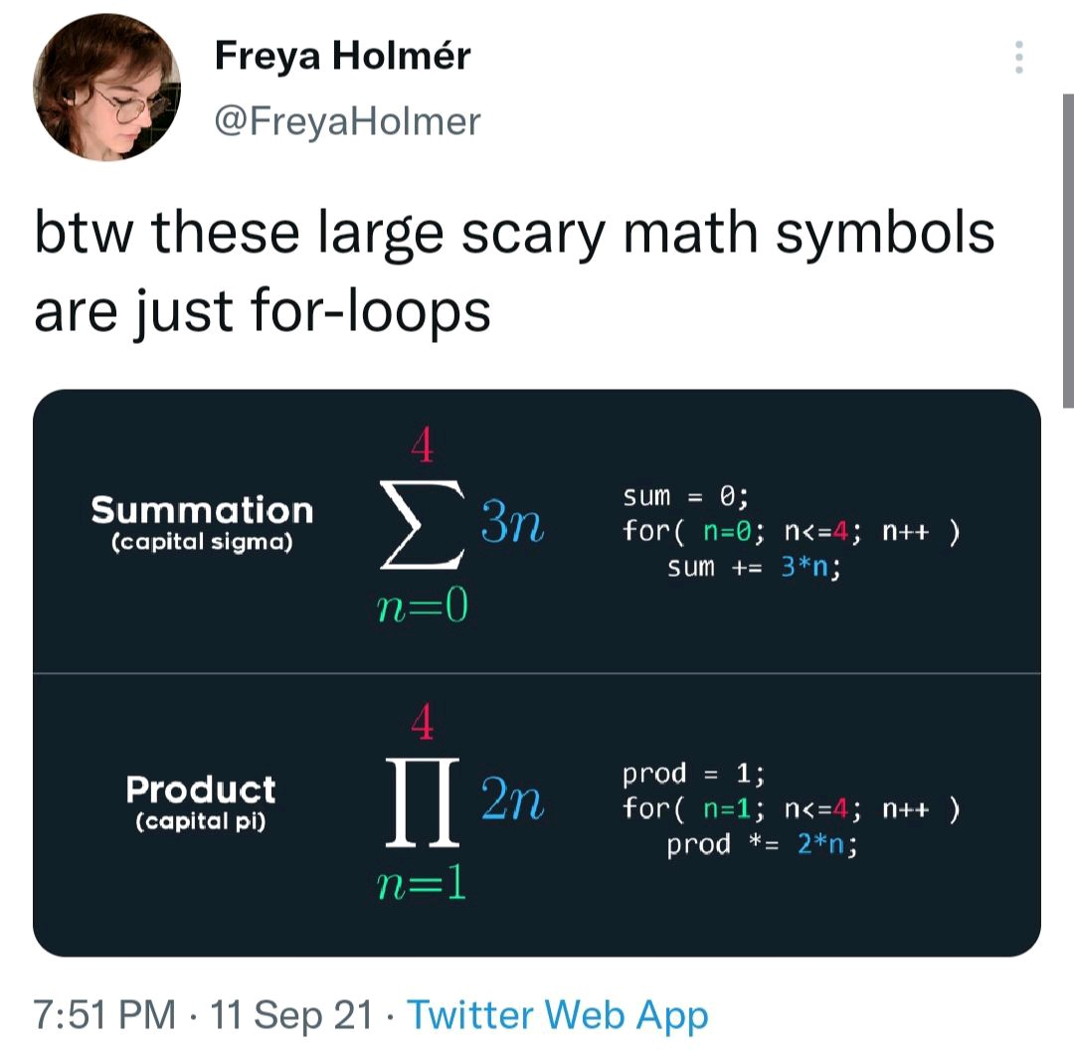
HOW EFFECTIVE OF USING FOR LOOP – MEME EXPLANATION

Slide 15
Counting in a Loop
$ python countloop.py
Before 0
1 9
2 41
3 12
4 3
5 74
6 15
After 6
zork = 0
print('Before', zork)
for thing in [9, 41, 12, 3, 74, 15] :
zork = zork + 1
print(zork, thing)
print('After', zork)
To count how many times we execute a loop, we introduce a counter variable that starts at 0 and we add one to it each time through the loop.

Slide 16
Summing in a Loop
$ python countloop.py
Before 0
9 9
50 41
62 12
65 3
139 74
154 15
After 154
zork = 0
print('Before', zork)
for thing in [9, 41, 12, 3, 74, 15] :
zork = zork + thing
print(zork, thing)
print('After', zork)
To add up a value we encounter in a loop, we introduce a sum variable that starts at 0 and we add the value to the sum each time through the loop.

Slide 17
Finding the Average in a Loop
$ python averageloop.py
Before 0 0
1 9 9
2 50 41
3 62 12
4 65 3
5 139 74
6 154 15
After 6 154 25.666
count = 0
sum = 0
print('Before', count, sum)
for value in [9, 41, 12, 3, 74, 15] :
count = count + 1
sum = sum + value
print(count, sum, value)
print('After', count, sum, sum / count)
An average just combines the counting and sum patterns and divides when the loop is done.

Slide 18
Filtering in a Loop
print('Before')
for value in [9, 41, 12, 3, 74, 15] :
if value > 20:
print('Large number',value)
print('After')
$ python search1.py
Before
Large number 41
Large number 74
After
We use an if statement in the loop to catch / filter the values we are looking for.

Slide 19
Search Using a Boolean Variable
$ python search1.py
Before False
False 9
False 41
False 12
True 3
True 74
True 15
After True
found = False
print('Before', found)
for value in [9, 41, 12, 3, 74, 15] :
if value == 3 :
found = True
print(found, value)
print('After', found)
If we just want to search and know if a value was found, we use a variable that starts at False and is set to True as soon as we find what we are looking for.

Slide 20
HOW TO FIND THE SMALLEST VALUE
$ python largest.py
Before -1
9 9
41 41
41 12
41 3
74 74
74 15
After 74
largest_so_far = -1
print('Before', largest_so_far)
for the_num in [9, 41, 12, 3, 74, 15] :
if the_num > largest_so_far :
largest_so_far = the_num
print(largest_so_far, the_num)
print('After', largest_so_far)
How would we change this to make it find the smallest value in the list?

Slide 21
FINDING THE SMALLEST VALUE
smallest_so_far = -1
print('Before', smallest_so_far)
for the_num in [9, 41, 12, 3, 74, 15] :
if the_num < smallest_so_far :
smallest_so_far = the_num
print(smallest_so_far, the_num)
print('After', smallest_so_far)
We switched the variable name to smallest_so_far and switched the > to <

Slide 22
FINDING THE SMALLEST VALUE
$ python smallbad.py
Before -1
-1 9
-1 41
-1 12
-1 3
-1 74
-1 15
After -1
smallest_so_far = -1
print('Before', smallest_so_far)
for the_num in [9, 41, 12, 3, 74, 15] :
if the_num < smallest_so_far :
smallest_so_far = the_num
print(smallest_so_far, the_num)
print('After', smallest_so_far)
We switched the variable name to smallest_so_far and switched the > to <

Slide 23
FINDING THE SMALLEST VALUE
smallest = None
print('Before')
for value in [9, 41, 12, 3, 74, 15] :
if smallest is None :
smallest = value
elif value < smallest :
smallest = value
print(smallest, value)
print('After', smallest)
$ python smallest.py
Before
9 9
9 41
9 12
3 3
3 74
3 15
After 3
We still have a variable that is the smallest so far. The first time through the loop smallest is None, so we take the first value to be the smallest.

Slide 24
The is and is not Operators
Python has an is operator that can be used in logical expressions
Implies “is the same as”
Similar to, but stronger than ==
is not also is a logical operator
smallest = None
print('Before')
for value in [3, 41, 12, 9, 74, 15] :
if smallest is None :
smallest = value
elif value < smallest :
smallest = value
print(smallest, value)
print('After', smallest)

